Slide 1

NOTE-NODES
Group No. 12
Presented By:-
Prajwal Negi 204200146
Lalit Rathore 204200110
Pradeep Sharma 204200145
Ravi Sharma 204200168
Om Singh Raghav 204200140
Nitesh Deshwal 204200139
Manish Tiwary 204200115
Under the Supervision of :
Mr. Puneet Sharma
Department of CEA
GLA University, Mathura

Slide 2
Contents
Introduction
Objective
Tools and technologies
Hardware and Software Requirements

Slide 3
Introduction
This program will help students to make handy notes
Will help them organize their both physical and e-notes into the form of folders and pdfs
The notes that will be made can later be converted into PDF and DOCX format for using it on other devices like PC, Laptops or other file reading apps

Slide 4
Objectives
Make notes making easier
Provide the better way to organize your documents
Keeps tracks of all your documents and makes them portable by storing them in once place
Editing and adding comments on the notes themselves
Can be later converted into other documents if required
Sharing is also easy

Slide 5
Technologies and Tools
TOOLS
Android Studio – This IDE provides with perfect environment to build, develop, run and test our android application both frontend and backend
Java – Java ensures all the backend of our app
Firebase – Provides API for authentication and storage of the database
FIGMA – For designing the whole interface UI and UX of the application
XML – For developing the layout of our application

Slide 6
DFD 0
Notes making app
Student
Adds notes
Database
Store and Retrieve Notes
Views notes

Slide 7
DFD 1
Notes making app
Student
Adds notes
Database
Store and Retrieve Notes
Views notes
Sharing
Data
Word/PDF file
Update Number of Notes, Directores and length
File Converter
Meta Database All the files and directores

Slide 8
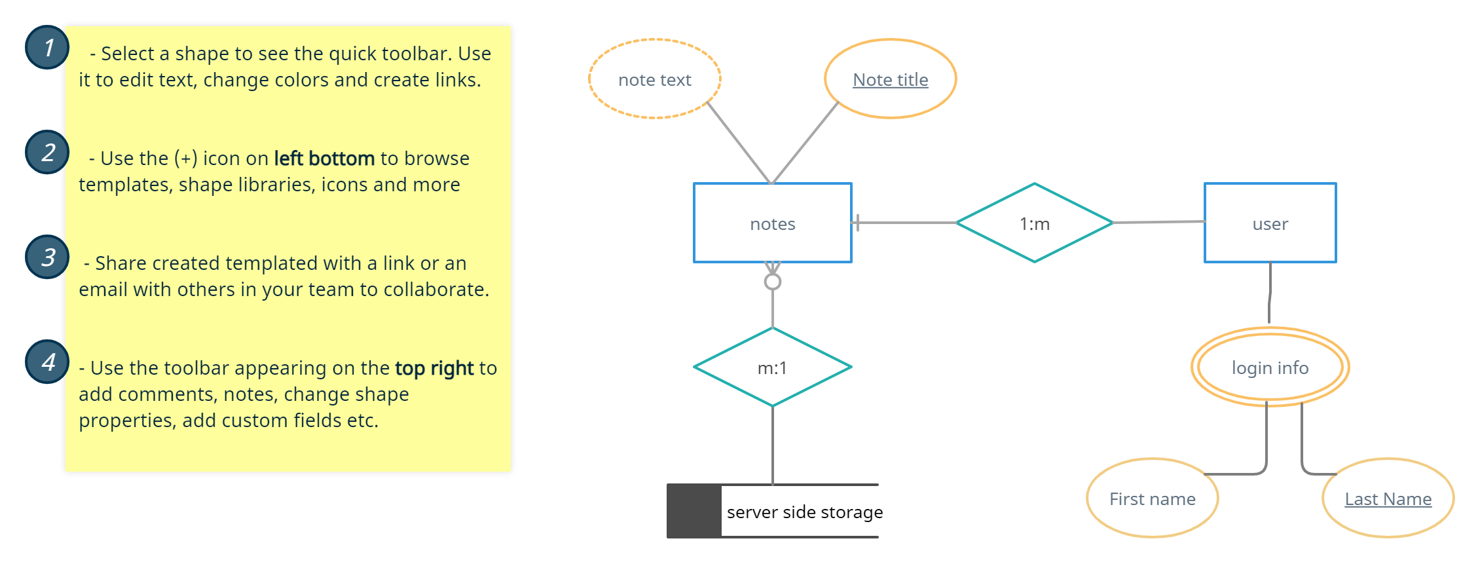
ER Diagram

Slide 9
Hardware and Software Requirements
Hardware
Quad Core Snapdragon/Mediatek Processor
1 GB RAM
1GB Storage
Software
Android version 10 or above

Slide 10
Conclusion
User will be able to make their documents organized
Can carry their documents OTG in the text format (on the go)
Sharing is easy
Can be converted into DOC and PDF format
Removes the load of carrying several notebooks

Slide 11
Thank You !

